Slide 1
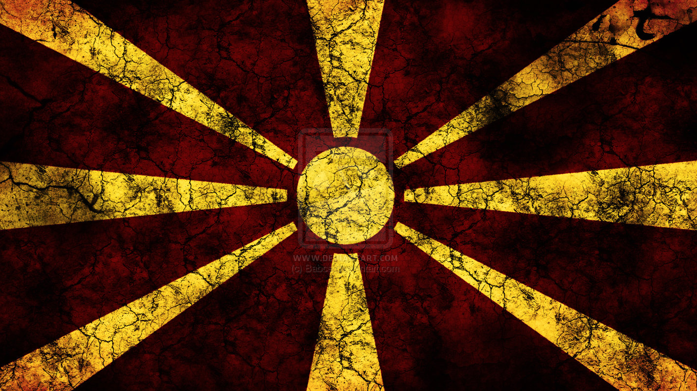
Countering Holocaust Denial in the Bulgarian North Macedonia Dispute
By Will Morton

Slide 2
Introductory Statement
This presentation covers potentially triggering material surrounding the Holocaust and mass deportations by the Kingdom of Bulgaria in World War Two. Images in this presentation have been carefully selected for a wider audience.
The so-called “Macedonian Question” refers to a long-standing scholarly debate surrounding the exact genesis of Macedonian national identity and the role that communist partisans had in its creation. This presentation takes no direct stance on this complex issue. Instead, this presentation is intended to highlight the existence and proliferation of Holocaust denial within the ongoing dispute between North Macedonia and Bulgaria.

Slide 3
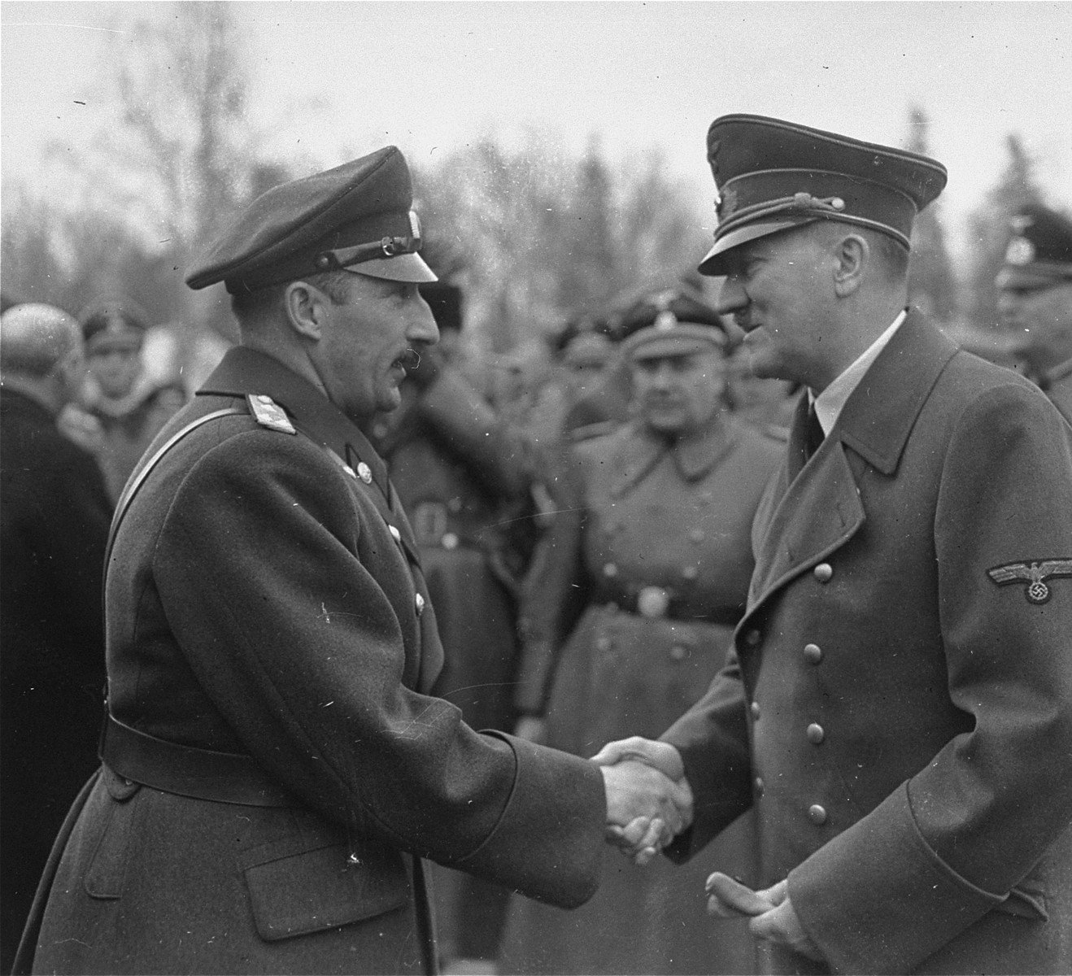
Kingdom of Bulgaria
Lead by King Boris III.
Concerned with reclaiming land lost in WWI (Beorn 196).
Initially predominantly neutral.
Passed antisemitic legislation based on the Nuremburg Laws (Beorn 197).

Slide 4
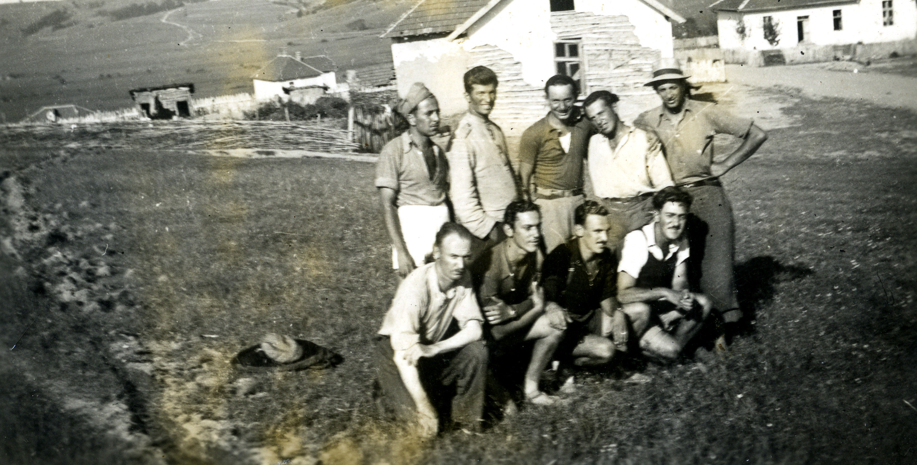
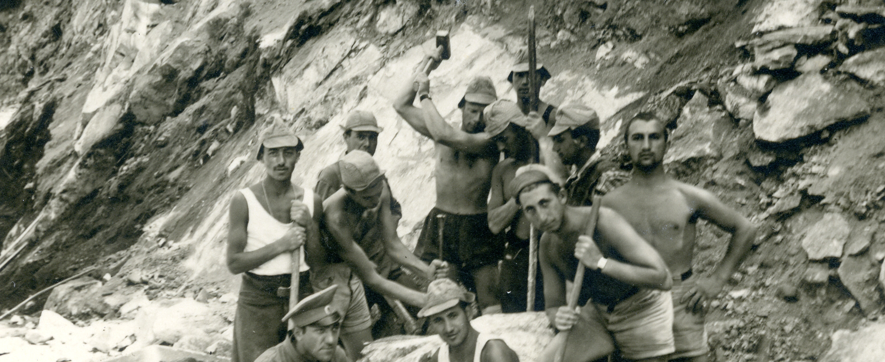
Neutrality Falls Antisemitism Rises
In 1941, Boris III made an alliance with Hitler to join the Axis Powers.
Bulgaria would allow free travel of German troops in exchange for Macedonia and Thrace.
Appointment of extreme anti-semite Aleksandar Belev (Benbassa 176).
Open discussion on how to align Bulgaria with Nazi values.
Eventual deportation of 20,000 Jews from the capital into outer regions (Benbassa 177)
The forcing of 7,000 jews into forced labor camps (Benbassa 178)

Slide 5
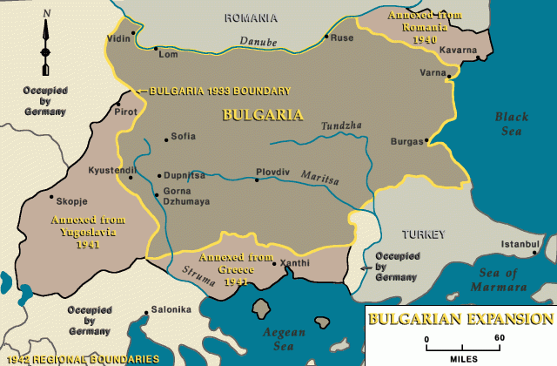
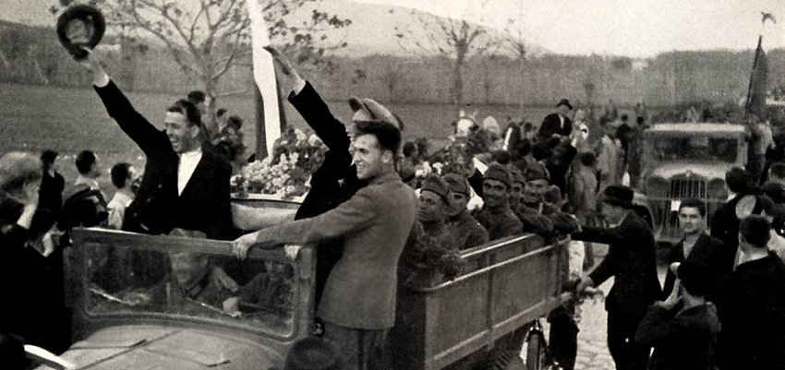
The Conquest of Macedonia and Greece
Bulgaria considered these areas to be “recently liberated territories”, or “under Bulgarian administration” but were in reality treated as “an occupied area” (Chary 45).
Non-Bulgarians discriminated against with mass murder, looting and rape (Benbassa 174).
All Jews in the annexed regions denied citizenship and treated as stateless (Beorn 197).

Slide 6
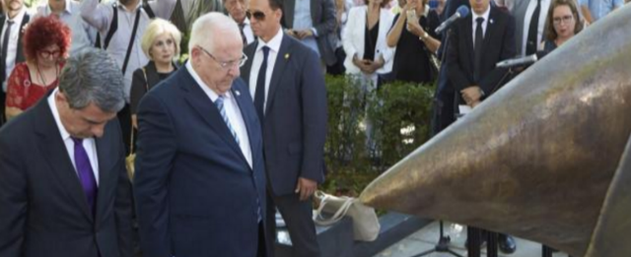
Bulgaria the Heroes of the Holocaust?
In 1943 the Dannecker-Belev agreement was signed setting out the plan to deport Jews starting in annexed regions (Chary 208).
Originally the agreement was to only be for the deportation of annexed regions, however it was amended to include all of Bulgaria(Chary 83).
Bulgaria would stop short of deporting mainland Bulgaria Jews to death camps (Chary 139).

Slide 7
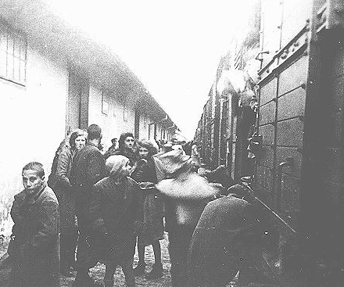
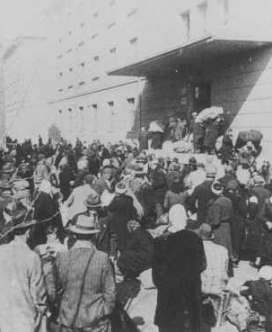
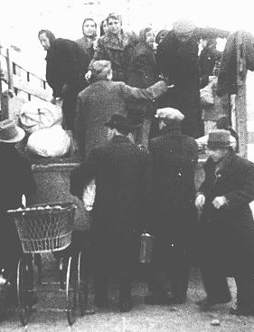
The Truth
However, this was only after Boris III approved the systematic rounding up and extermination of over 11,000 Jews by Bulgarian police (Beorn 195).
The police often committed acts of rape and looting in the process of enacting The Final Solution in Macedonia and Thrace (Beorn 198).

Slide 8
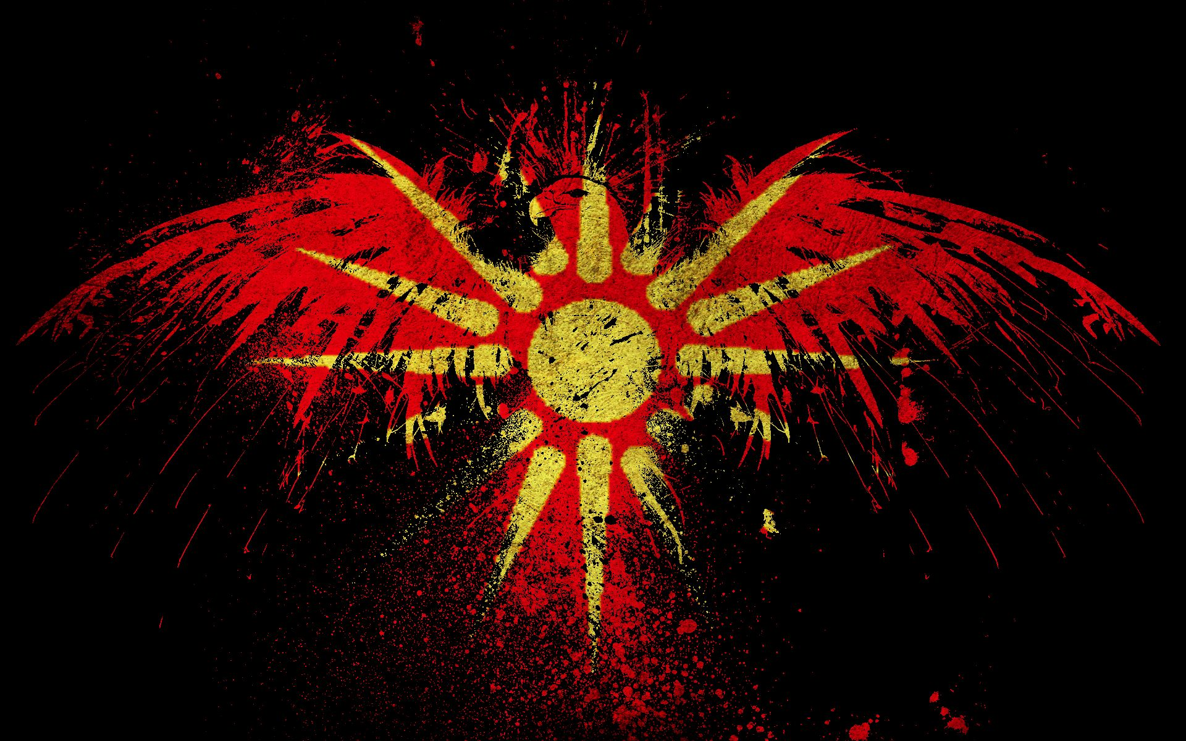
The New Macedonian State
After WWII, the communists took over.
Macedonia became part of the new Yugoslavia.
During the Balkan Wars of the 90’s Macedonia breaks off and forms an independent country.

Slide 9
Bulgaria intervenes
Greece blocks Macedonia from accession starting in 2007 until 2018 Prespa Agreement (Topalova).
2017 preliminary joint historical commission established to solve historical disputes between North Macedonia and Bulgaria (Cheresheva).
November 17, 2020, Bulgaria blocks North Macedonia’s EU accession (Marusic).

Slide 10
Bulgarian Demands
Bulgaria Demands the term "Bulgarian Fascist Occupying Forces.” To be erased from all textbooks and WW II monuments (Maursic).
The recognition of a Bulgarian minority in North Macedonia in North Macedonia’s constitution.
Delegitimization of the idea of a Macedonian language (Maursic).
The criminalization of hate speech such as connecting Bulgaria to the Holocaust in Macedonia (Maursic).

Slide 11
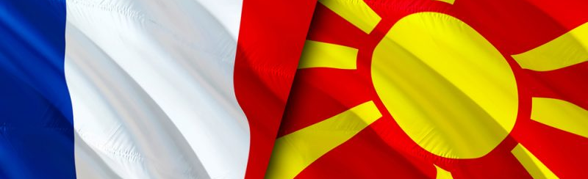
French Proposal
June of 2022, the EU-endorsed French Deal emerged (Taylor).
Under this “deal” North Macedonia must give into all Bulgarian demands and amend their constitution (Taylor).
These changes include recognizing a Bulgarian minority, denouncing the existence of an independent Macedonian language, and criminalizing “hate speech” against Bulgaria (Gijs).
In addition to these changes, under the deal Bulgaria has the right to block North Macedonia again at any time (Taylor).
This would prove so unpopular in Bulgaria that it would contribute to a vote of no confidence against the Prime Minister that has culminated in snap elections in October (Taylor).

Slide 12
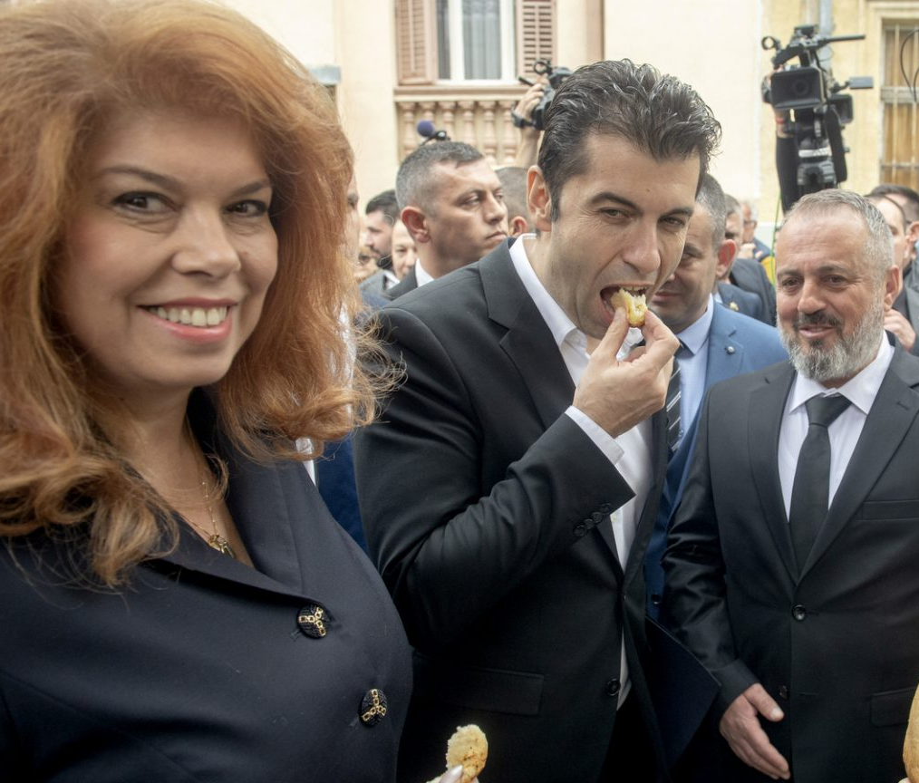
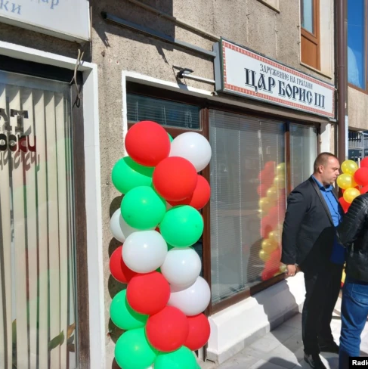
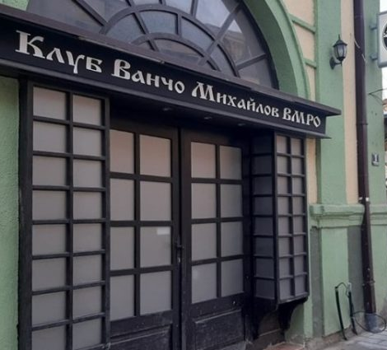
“Cultural Centers”
Ivan Mihailov Cultural club opened in April 2022 in Bitola North Macedonia (Maursic).
Opening attended by the Prime Minister of Bulgaria and Vice President (Nikolov).
Ivan Mihalilov club damaged by protests in June (Nikolov)
Boris III club opened in October 2022 in Orhid North Macedonia (Todorov).
Boris III club vandalized later that month by protestors (Todorov).

Slide 13
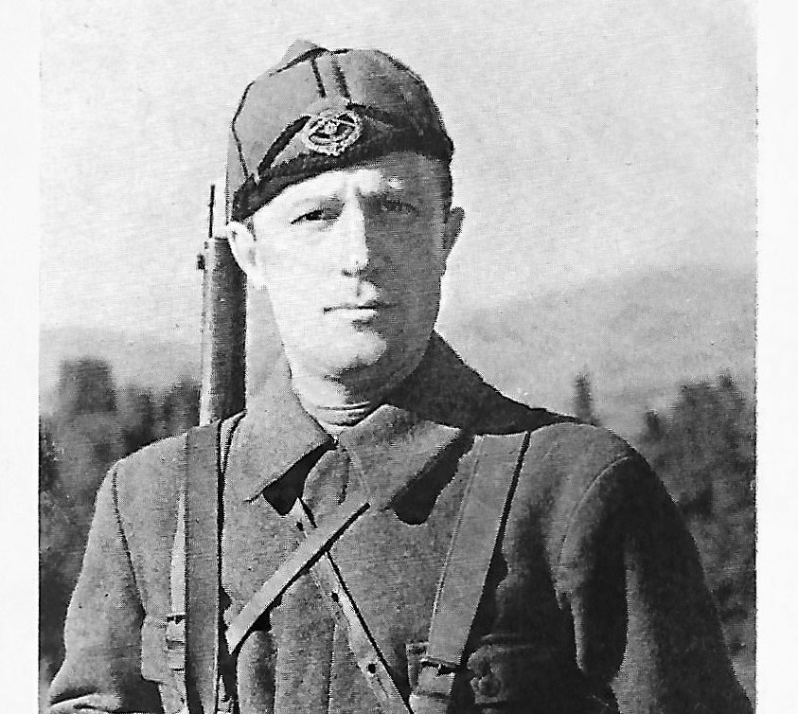
Glorification of Nazi Collaborators
King Boris III Bio (Benbassa 173-179)
Allied with Hitler to retake lost land
Passed antisemitic laws in Bulgaria
Oversaw the forced deportation of 20,000 Jews from Sofia to outer regions
Directly signed off on the agreement to enact the Final Solution in Bulgaria and occupied territories
Ivan Mihailov. (Chary 164-175).
Lived in Croatia as a guest of the Fascist Ustasha.
Was courted by the Nazis to Set up a Nazi Puppet State in Macedonia.
Worked as Nazi agent and failed to achieve this goal.
w

Slide 14
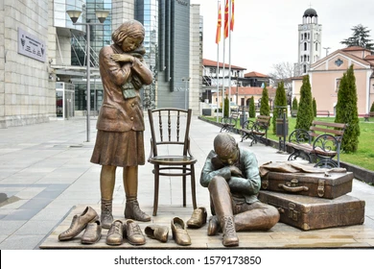
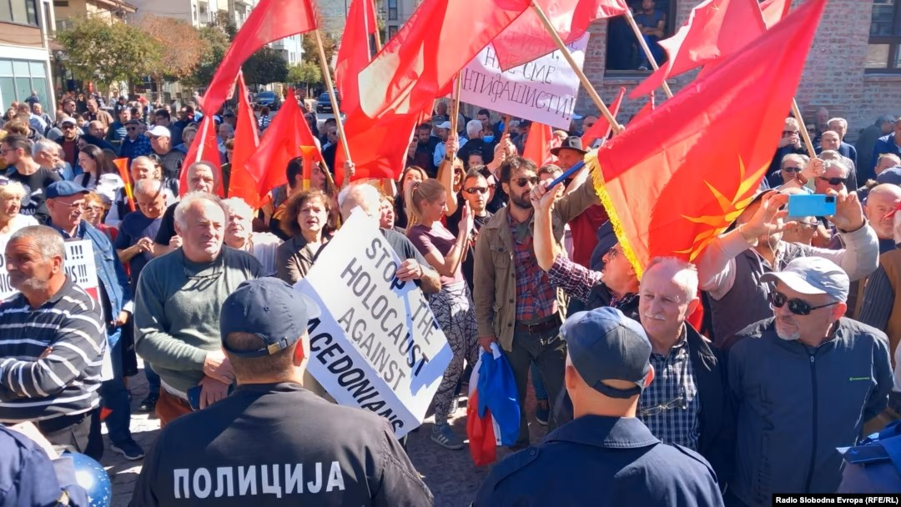
Ban of Names Associated with Nazis
Local Jewish groups came out against the opening of these two clubs (Testorides).
In early November North Macedonia passed legislation that banned the naming of buildings after people or things associated with Fascism and the Holocaust (Testorides).
Bulgaria's Foreign Ministry has responded by saying that Bulgaria has “serious concerns that they [the amendments] are aimed at discriminatory restriction of the right of association of Bulgarians in North Macedonia, for which the one-sided interpretation of historical facts is the reason” (Marusicj).

Slide 15
Conclusion
In conclusion, in its policy towards North Macedonia Bulgaria is promoting and supporting Holocaust revisionism and uplifting Nazi collaborators as national heroes. Furthermore, the French Proposal would force North Macedonia to give into Bulgarian revisionist demands. Holocaust revisionism has no place in this world and should be called out and countered wherever possible.

Slide 16
Never Again
Picture Citations: shorturl.at/iuwWY
Information Citations: shorturl.at/GKNU2
Information on North Macedonia Holocaust Museum: shorturl.at/hzHP3
Eastern Europe Holocaust Fund: shorturl.at/aDRZ6

