Slide 1
The European Union and the Euro Crisis
Layna Mosley
Dept. of Political Science
UNC Chapel Hill
mosley@unc.edu

Slide 2
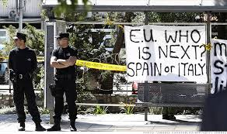
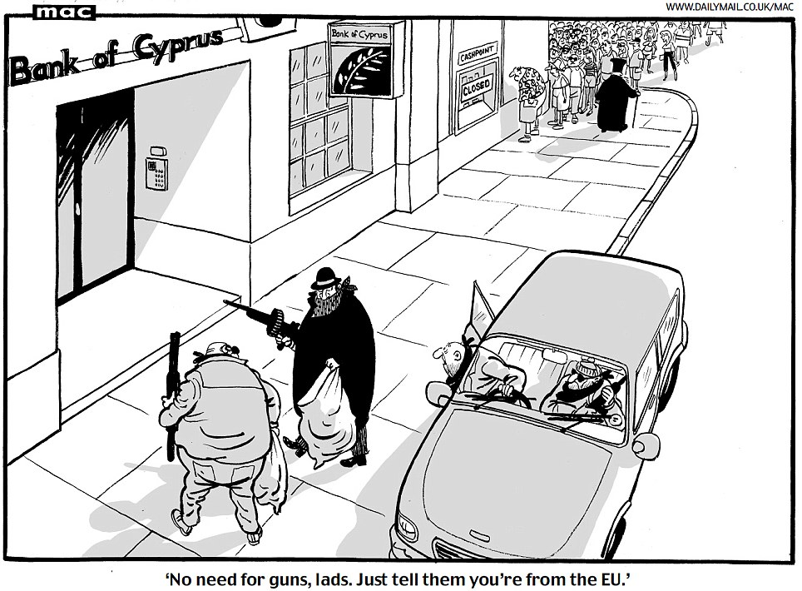
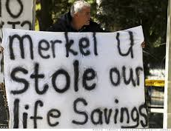
Cyprus, March 2013
Cyprus joined EU in 2004, and the eurozone in 2008

Slide 3
Outline
The making of Economic and Monetary Union (EMU)
The 2000s: Market Enthusiasm
2009-2013: Crisis and Austerity

Slide 4
The making of EMU
Werner Report, 1970
Coordination of exchange rates
European Monetary System & ERM, 1979-1999
Maastricht Treaty, 1992
Economic and Monetary Union (EMU)
Economic as well as political motivations
Shared currency (euro)
European Central Bank to determine monetary policy (interest rates)
Criteria for membership
Inflation, interest rate convergence
Fiscal deficits (<3%/GDP), government debt (<60%/GDP, or declining toward that)

Slide 5
The making of EMU
1998: determination of which countries meet the convergence criteria
Opt outs: Denmark, Sweden, UK
1999: the Euro comes into existence, with 11 members
Post-EMU fiscal discipline: the Stability and Growth Pact
Monitors deficit and debt on an annual basis
2001: Greece joins the eurozone
2002: physical currency begins to circulate
2007: Slovenia joins
2008: Malta and Cyprus join
2009: Slovakia joins
2011: Estonia joins

Slide 6
The first decade: market enthusiasm
Eurozone:
Interest rate convergence, despite differences in economic fundamentals

Slide 7
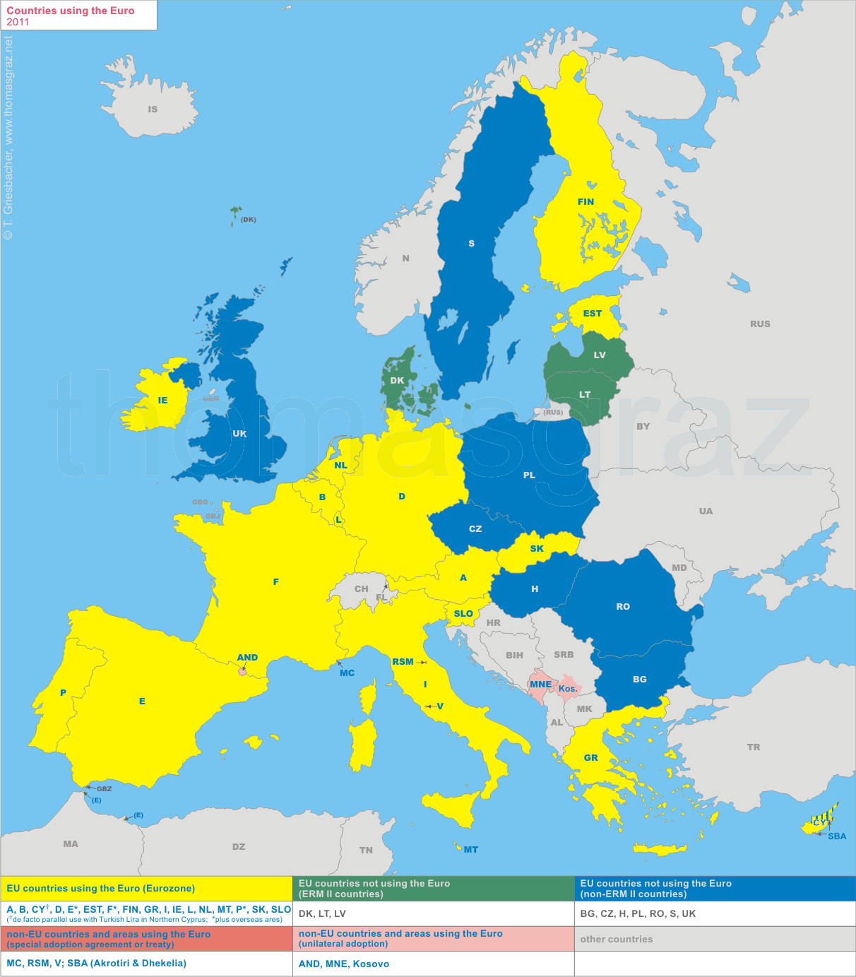
The Euro
The share of the euro as a reserve currency increased from 17.9% globally in 1999 to 26.5% in 2008
2011: 24.9%
US dollar 2011: 61.8%

Slide 8
The first decade: market enthusiasm
Violations of the Stability and Growth Pact occur…
The earliest violators (2002-2005) include Greece and Portugal –
But also France and Germany
Large EU members don’t face Excessive Deficit Procedures
But investors don’t seem bothered by violations.
Why? Assumption that bailouts would occur?
Timeline of the crisis: http://www.bbc.co.uk/news/business-13856580

Slide 9
Crisis and Austerity (I)
Collapse of real estate markets in Ireland and Spain.
Weakly regulated banks are bailed out.
Southern European economies have difficulty competing on world markets
But can’t devalue their currency.
And the ECB won’t lower interest rates, as not all eurozone countries face slowdowns.
Budget deficits widen as eurozone economies face rising unemployment.

Slide 10
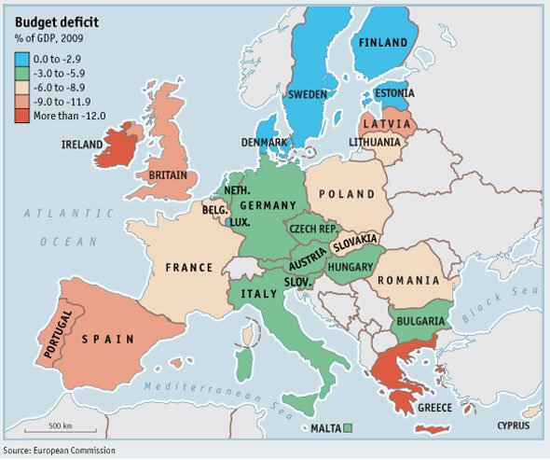

Slide 11
Crisis and Austerity (II)
Fiscal news gets worse
2009: EU orders France, Greece, Ireland and Spain to reduce deficits
“Severe irregularities” in Greek accounting; deficit revised from 3.7% to 12.7% of GDP
Downgrades of sovereign debt
Investors no longer assume that EU member government debt is free from default risk
December 2009: ratings downgrades for Greek debt – which is 113% of GDP
January 2012: downgrades of France and eight other eurozone governments
Increases in interest rates on gov’t bonds
August 2011: ECB begins buying Italian and Spanish government bonds, to try to bring down borrowing costs.

Slide 12
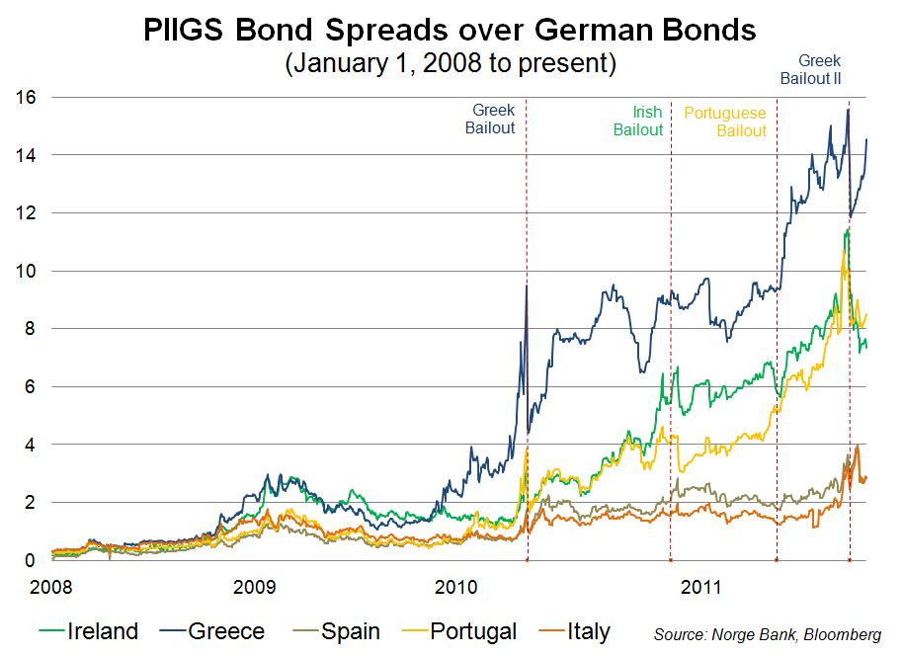

Slide 13
Crisis and Austerity (III)
Austerity
Greece announces numerous rounds of austerity measures, beginning in Feb. 2010
Ireland: November 2010, toughest budget in history.
Bailout packages
May 2010, March 2012: EU/IMF bailout packages for Greece
Nov. 2010: bailout for Ireland
February 2011: European Stability Mechanism, a permanent bailout fund, established.
May 2011: bailout for Portugal
March 2013: bailout for Cyprus?

Slide 15
Why Bailouts?
Bailouts generate backlash in bailed-out countries as well as elsewhere in the EU.
Require agreement with European Commission, ECB and Int’l Monetary Fund
Concerns about stability of private banks – in PIIGs and elsewhere in the EU
In the peripheral countries, struggling banks have cut credit, worsening the recession.
Worries about the euro, both in terms of its global image and in terms of keeping countries in.
Stronger fiscal rules agreed to in January 2012.

Slide 16
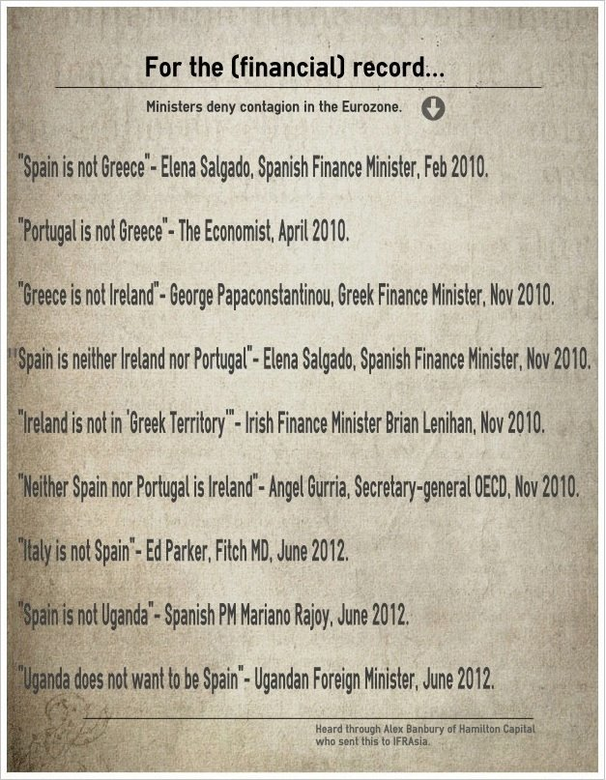

Slide 17
Caveats
The entire Euro area faces economic challenges:
Growth rate of 0.4% (2012), -0.2% (2013)
Unemployment rate of 11.2% (2012), 11.5% (2013)
US in 2012: growth 2.2%, unemployment 8.2%
But not all crises were created equally:
Greece: large fiscal deficits, high debt levels, tax evasion, low savings rate
Portugal: low savings rate, fiscal deficits
Spain: property market bubble, persistent unemployment.
Ireland: pre-crisis debt/GDP of 25%. Property market bubble, banking crisis, bank bailout.
Italy: better savings rate and external balance than the others, but large in terms of absolute amount of debt.

Slide 18
Additional Slides

Slide 19
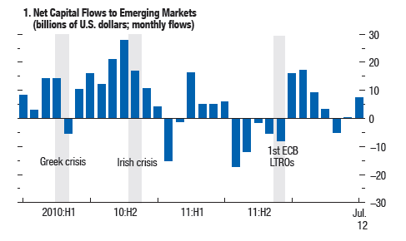

Slide 21
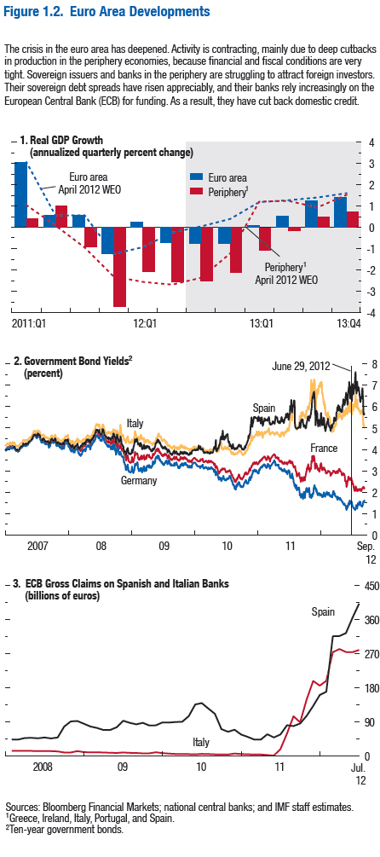
WEO Oct 2013: http://www.imf.org/external/pubs/ft/weo/2012/02/pdf/text.pdf

Slide 22
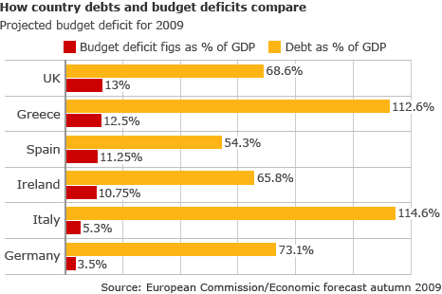

Slide 23
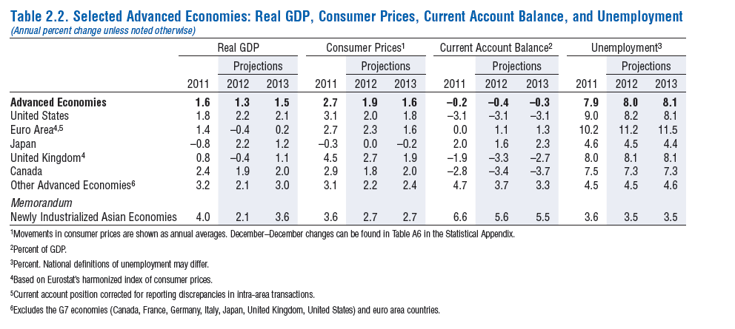

Slide 24
With the crisis, a renewed attention to default risk, and to differences across countries.
Reward for EMU disappears, or at least is reduced.
Chart: variance in government bond rates among OECD nations.

Slide 25
More generally, developed nations are more indebted than their emerging market counterparts.
Source: Bank for International Settlements, 2012 Annual Report

