Slide 1
US-EU relations a delicate rebalancing act
Liesbet Hooghe
Kenan Professor in Political Science
University of North Carolina

Slide 2
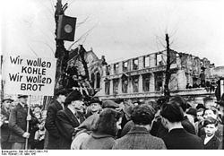

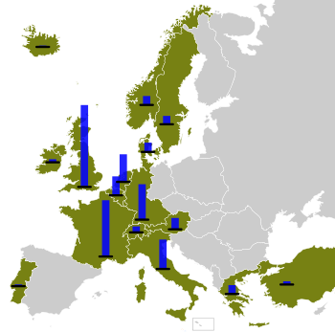
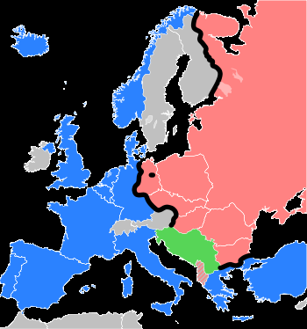
MARSHALL PLAN (1948-1952)

Slide 3
Trade
  a transatlantic single market?
  imagined and real obstacles
Security
  Bush legacy
  soft vs. hard power
  international law
Foreign policy
  democracy promotion
  EU’s special tool: enlargement

Slide 4
Trade

Slide 5
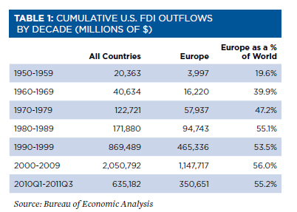

Direct investment
Notes:
Biggest trading partners – especially in FDI. The bias is even greater the other way – about 75 percent of EU FDI is in the US. And this has not changed much since the early 1990s. So globalization has not shifted this much. Biggest recipient in Europe: the Netherlands, followed by UK, then Canada, then Ireland, Switzerland.
European investment in the U.S.—on a historic cost basis—totaled $1.7 trillion in 2010, or 72% of total foreign direct investment in the U.S. Companies from the UK, followed by Japan, the Netherlands, Germany, and Canada were the largest foreign investors in the U.S.

Slide 6
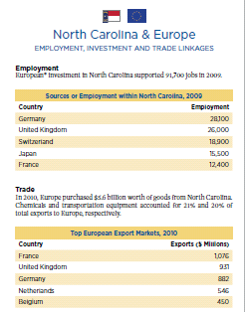
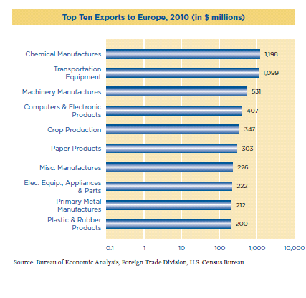
Notes:
North Carolina is benefiting pretty handily

Slide 7
EU-US Not the only game in town
Notes:
. . . But transatlantic partnership is becoming a shrinking part of the world economy

Slide 8
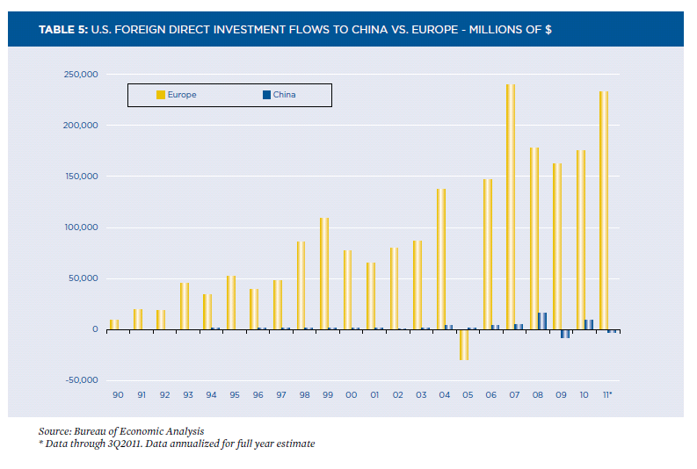
. . . but do not overrate the competition!

Slide 9
Obstacles
China hype
Different interests and policies
Different philosophies about government
Single market? Spillover?

Slide 10
Security

Slide 11
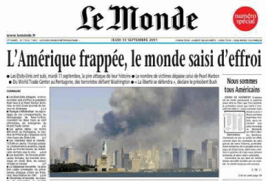
The Twin Towers
Shared grief
Common resolve
The Parties agree that an armed attack against one or more of them in Europe or North America shall be considered an attack against them all and consequently they agree that, if such an armed attack occurs, each of them, in exercise of the right of individual or collective self-defence recognised by Article 51 of the Charter of the United Nations, will assist the Party or Parties so attacked by taking forthwith, individually and in concert with the other Parties, such action as it deems necessary, including the use of armed force, to restore and maintain the security of the North Atlantic area.
NATO invokes Article V
Notes:
Senior protector US and the protected European countries.
Then this shock.

Slide 12
A PARTING OF THE WAYS contentious dossiers
Iraq
Foreign Aid/Debt Relief
International Criminal Court
Kyoto Protocol, global warming
Economic protectionism
Landmines
Genetically modified foods
Notes:
While only the beginning, the road to the 60 ratifications (now around 90) has been full of controversy. In Rome, July 1998, the ICC was given the go-ahead with a vote of 120 to 7. The seven who voted against were USA, China, Iraq, Israel, Libya, Qatar and Yemen. Almost all of USA's allies voted for the ICC, while the Unites States was surprisingly very vocally against it and left standing with a list of countries that included those that the U.S. itself has termed as "rogue". Various human rights and social justice groups have long criticized the U.S. who continue to oppose the International Criminal Court, even as they dropped out in May 2002.
The Obama administration has established a working relationship with the court but has not signed.
With the looming deadline to sign the International Criminal Court at the end of December 2000, the United States signed, as did some other nations, so that it would allow them to be involved in future negotiations about this treaty.
US, together with Russia and China and some 32 other countries, have not signed the treaty. Neither South Korea nor North Korea have signed. Smart mines don't impress human rights groups, which say the world would be better served if the United States joined the 150 nations that have signed the 1997 Ottawa treaty banning mines altogether.

Slide 13
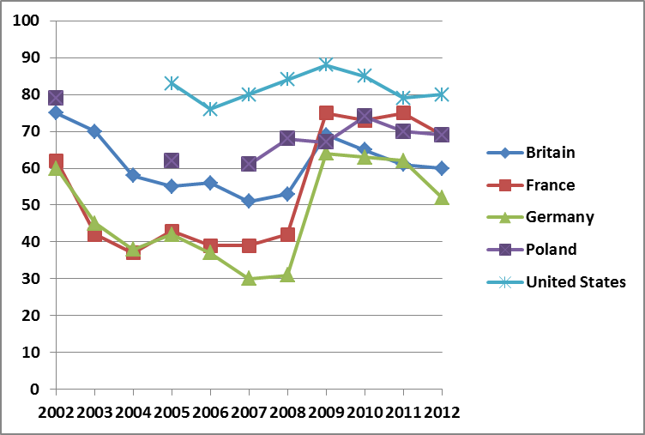
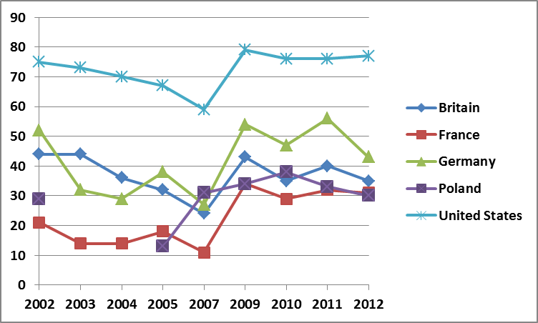
Percentage favorable opinion
of the United States
Percentage thinking that US takes into account interests of [country] in international policy
Full question wording: Please tell me if you have a very favorable, somewhat favorable, somewhat unfavorable or very unfavorable opinion of the United States.
Full question wording: In making international policy decisions, to what extent do you think the United States takes into account the interests of countries like (survey country) - a great deal, a fair amount, not too much, or not at all?
Source: Pew Foundation Public Opinion Surveys, see website

Slide 14
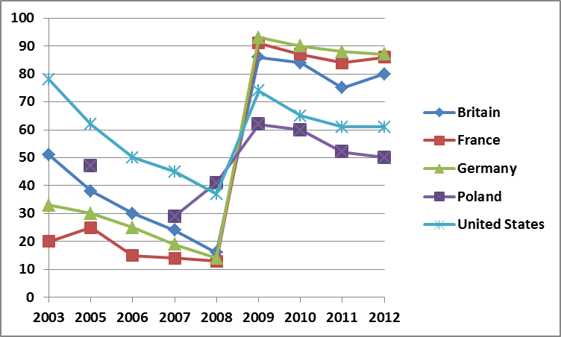
Percentage having confidence in US president
Full question wording: Now I'm going to read a list of political leaders. For each, tell me how much confidence you have in each leader to do the right thing regarding world affairs - a lot of confidence, some confidence, not too much confidence, or no confidence at all. U.S. President George W. Bush (2002-2008), Barack Obama (2009)

Slide 15
Robert Kagan’s argument
“Americans are from Mars – Europeans are from Venus”
America is powerful; Europe is weak
America has a stick and wants to use it
Europe does not, and wants to avoid fights
Robert Kagan, “Power and Weakness,” Policy Review, No. 113, June 2002.

Slide 16
Robert Kagan on the EU
“Europeans insist they approach problems with greater nuance and sophistication. They try to influence others through subtlety and indirection. They are more tolerant of failure, more patient when solutions don’t come quickly. They generally favor peaceful responses to problems, preferring negotiation, diplomacy, and persuasion to coercion. They are quicker to appeal to international law, international conventions, and international opinion to adjudicate disputes. They try to use commercial and economic ties to bind nations together. They often emphasize process over result, believing that ultimately process can become substance.”
Robert Kagan, “Power and Weakness”

Slide 17
Defense expenditure (billion $)
Source: CRS report for Congress, Jan 2004. http://www.fas.org/man/crs/RL32209.pdf,
And for 2011: International Institute for Strategic Studies
Notes:
17

Slide 18
Foreign aid (billion $, in 2009 prices)
http://www.oecd.org/dac/aidstatistics/statisticsonresourceflowstodevelopingcountries.htm

Slide 19
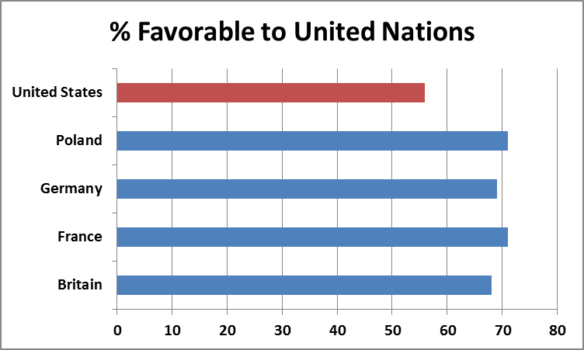
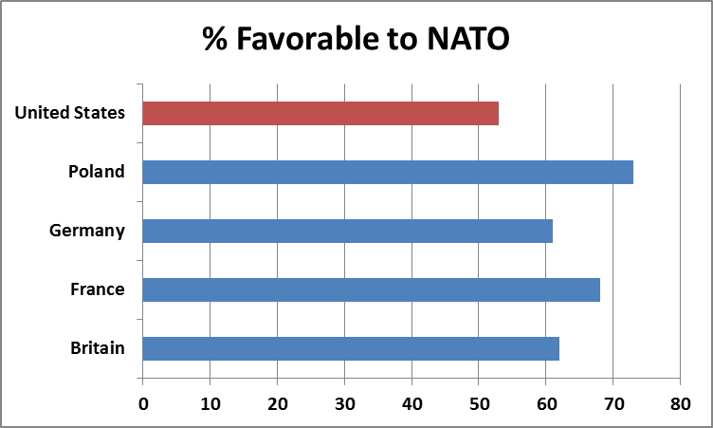
Lingering differences: international law
Full question wording: Please tell me if you have a very favorable, somewhat favorable, somewhat unfavorable or very unfavorable opinion of the United Nations.
Full question wording: Please tell me if you have a very favorable, somewhat favorable, somewhat unfavorable or very unfavorable opinion of NATO, that is, North Atlantic Treaty Organization?
Averages 2007-2012
Notes:
Underlying – apparently different views about the virtues of international cooperation

Slide 20
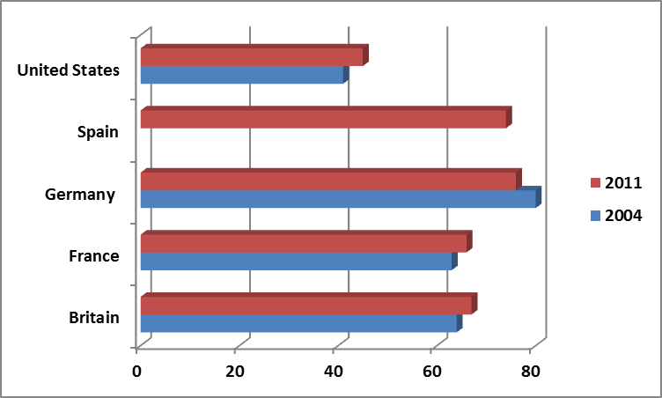
Percentage saying that country should have UN approval before using military force

Slide 21
Commitment to international law
EU Treaty of European Union:
“The Union shall define and implement a common foreign and security policy covering all areas of foreign and security policy, the objectives of which shall be:
— to safeguard the common values, fundamental interests, independence and integrity of the Union in conformity with the principles of the United Nations Charter,
— to strengthen the security of the Union in all ways,
— to preserve peace and strengthen international security, in accordance with the principles of the United Nations Charter, as well as the principles of the Helsinki Final Act and the objectives of the Paris Charter, including those on external borders,
— to promote international cooperation,
— to develop and consolidate democracy and the rule of law, and respect for human rights and fundamental freedoms.

Slide 22
Peace as overriding goal
Petersberg tasks (now art. 17):
  Humanitarian and rescue tasks
  Peacekeeping
  Tasks of combat forces in crisis management, including peacemaking.
  EU missions
Since 2009: Development of defense policy: “including the progressive framing of a common defence policy, which might lead to a common defence, should the European Council so decide.”

Slide 23
Foreign policy

Slide 24
Europe and the United States
Liberal democracy
Liberal:
  rule of law (i.e. impartiality before law, anti-corruption); freedom of expression; freedom of association, human rights
Democracy:
  competitive elections
Notes:
Europe and US: common values, common understanding of what is

Slide 25
Jeffrey Kopstein’s thesis
EU
US
Skeptical about capacity to create democracy, and certainly not by sword
Focus on state building and consolidation: rule of law, good governance
→ Work with judges, police forces, bureaucrats, political leaders
Top-down
Optimistic about capacity to create democracy, if necessary by force
Focus on society building and promotion: elections, civil society
→ Work with civil society groups, election monitoring, parties
Bottom-up
Notes:
Skeptical vs. optimistic on starting democracy, focused vs. negligent on stabilizing democracy
See Central and Eastern Europe – e.g. US idea that Balkan countries should become members of NATO and should get fast track into the EU. EU countries were aghast by both.
See policy towards Belarus or Georgia: should one engage Lukhashenko and Sakhashvili or isolate them? See Ukraine.

Slide 26
Different historical experiences
Social disorder can bring war, dictatorship, occupation, destruction (1930s).
Free elections can bring autocrats to power (Hitler, Mussolini).
Supranational rules (civilian power) can bring prosperity and stability (EU).
Supranational rules (normative power) can constrain illiberal state behavior (EU).
Notes:
Very different mind sets shaped by very different experiences.
Social disorder: 1930s – democracies very fragile in the face of the depression. Toppled in Germany, Italy, Austria, Czechoslovakia, Hungary, Spain, but also serious strains in France and Belgium. Cfr currently a much keener concern in Europe about the dangers of sharp recession for fragile East European democracies. Call for major aid to stabilize economies—and hence political systems.
Free elections: Hitler, Mussolini. We had Roosevelt! But if you wanted to do a thought experiment, read Philip Roth’s ‘ Plot against America’. The novel follows the fortunes of the Roth family during the Lindbergh presidency, as antisemitism becomes more accepted in American life and Jewish-American families like the Roths are persecuted on various levels. Roth based his novel on the isolationist ideas espoused by Lindbergh in real life as a spokesman for the America First Committee and his own experiences growing up in Newark, New Jersey.
On the positive side: the enabling power of supranational and international rules and institutions.
Prosperity: many scholars were pessimistic about the chances of democracy in postwar Europe. EI (kickstarted by the Marshall plan) laid the foundation for economic prosperity. With that – limits to national governments’ ability to become selfish, protectionist.
Normative power: e.g. clean government, minority rights (Czech example, Bulgarian example)

Slide 27
EU Enlargement

Slide 28
Copenhagen criteria
(since 1993)
“Membership requires that the candidate country has achieved stability of institutions guaranteeing . . .”
1) the rule of law, human rights and respect for, and protection of minorities
2) democracy
3) the existence of a functioning market economy
Notes:
June 1993 European Council in Copenhagen
When agreed in 1993, there was no mechanism for ensuring that any country which was already an EU member state was in compliance with these criteria. However, arrangements were put in place to police compliance with these criteria, following the "sanctions" imposed against the Austrian government of Wolfgang Schüssel in early 2000 by the other 14 Member States' governments. These arrangements came into effect on 1 February 2003 under the provisions of the Treaty of Nice.
15 YRS
MUCH TO DO-- LIBERAL DEMOCRACY, CIVIL SERVICE, JUDICIAL SYSTEM, MARKET
PLUS 80,000 PAGES OF ACQUIS
BIG BANG 1997
1990: European Commission coordinates western aid
1990-1993: partial free trade under Europa agreements
1998: negotiations start

Slide 29
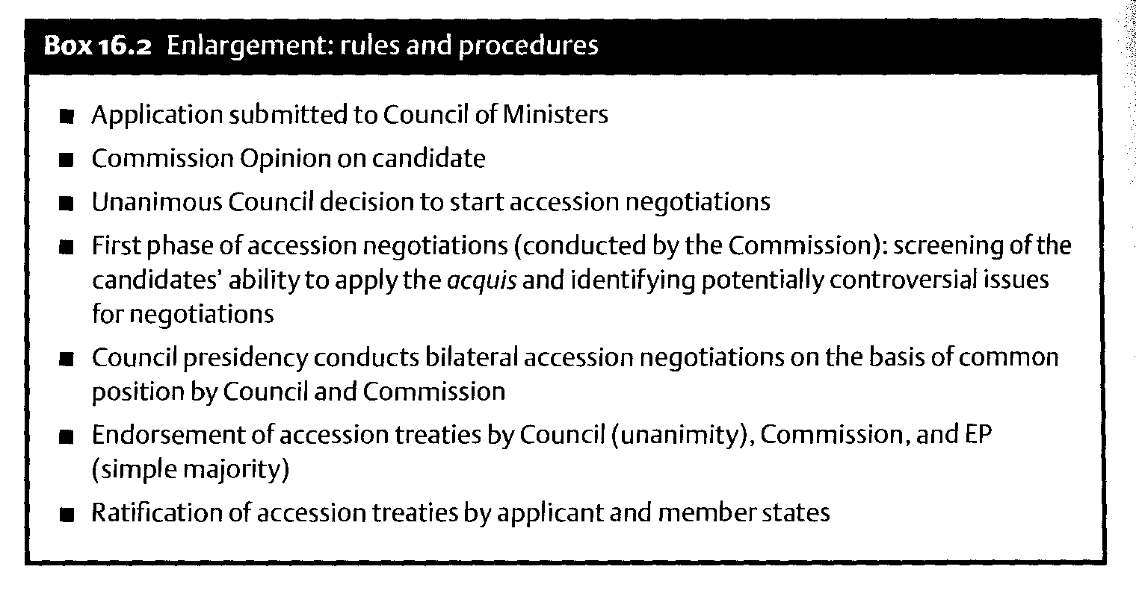
Notes:
If the Council agrees to open negotiations the screening process then begins. The Commission and candidate country examine its laws and those of the EU and determine what differences exist. The Council then recommends opening negotiations on "chapters" of law that it feels there is sufficient common ground to have constructive negotiations. Negotiations are typically a matter of the member state convincing the EU that its laws and administrative capacity are sufficient to execute European law, which can be implemented as seen fit by the member states. Often this will involve time-lines before the Acquis Communautaire (European regulations, directives & standards) has to be fully implemented.
Population and GDP per capita of EU member states and some candidates.
A chapter is said to be closed when both sides have agreed it has been implemented sufficiently, however it can still be re-opened if the Commission feels that the candidate has fallen out of compliance.
To assess progress achieved by countries in preparing for accession to the European Union, the European Commission submits regular reports (yearly) to the European Council. These serve as a basis for the Council to make decisions on negotiations or their extension to other candidates.

Slide 30
Accession negotiations: Screening
A multilateral exercise: the commission identifies and explains to all candidates the acquis applicable at the date of opening the negotiations with the candidates.
A bilateral exercise: the commission assesses the state of implementation of the acquis by each candidate country and identifies gaps to be filled.
A basis for the negotiation: the Commission establishes a "screening report" on each chapter and for each country, which will serve as a basis to launch the actual, technical negotiation process.
An ongoing mechanism: it is used now to identify and explain elements of NEW legislation, that also need to be adopted by the candidates before they join.

Slide 31
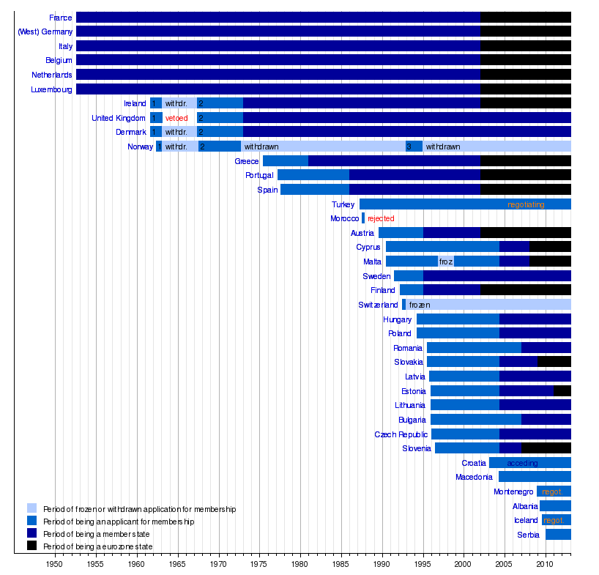

Slide 32
Example: Serbia
2003: EU Council identifies Serbia as potential candidate
2005: Negotiations start
  Stumbling blocs: Kosovo and cooperation with International
  Criminal Court
2008: Serbia signs agreement but blocked by the Netherlands until Ratko Mladic is captured in May 2011
Jan 2009: Serbia begins unilateral implementation of SAA
Dec 2009: EU unfreezes trade, visa-free travel, Serbia applies for EU membership
Nov 2010: Council asks Commission opinion on candidacy
Oct 2011: Commission recommends candidacy status
Feb 2012: Romania blocks candidacy until deal with Serbia over the rights of the 30,000 'Vlachs' in Serbia
March 2012: European Council approves candidacy status
Commission opinion October 2011
EU Enlargement website
Notes:
The government of Serbia set a goal for EU accession in 2014.[42][43] Negotiations on a Stabilisation and Association Agreement started in November 2005.[44] Serbia's candidacy was hindered by its relations with the breakaway state of Kosovo. Serbia made numerous concessions on this to achieve candidate status, such as allowing Kosovo to participate in regional forums, and jointly managing their border.[45]
On 29 April 2008, Serbian officials signed an SAA with the EU,[46] and the Serbian President sought official candidate status by the end of 2008.[47] The Dutch government refused to ratify the agreement while Ratko Mladić was not captured. He was captured in Serbia on 26 May 2011, removing the main obstacle for obtaining candidate status. As of January 2009, the Serbian government has started to implement its obligations under the agreement unilaterally.[48] The effects remain to be evaluated by the European Commission. Despite its setbacks in the political field, on 7 December 2009, EU unfroze the trade agreement with Serbia.[49] Serbian citizens gained visa-free travel to the Schengen zone on 19 December 2009,[50] and Serbia officially applied for the EU membership on 22 December 2009.[51]
In November 2010, The Economist stated that "EU Foreign Ministers have agreed to pass Serbia's request for membership to the European Commission".[52] The European Commission sent a legislative questionnaire of around 2500 questions[53] and Serbia answered to on 31 January 2011. On 12 October 2011, the European Commission has recommended that Serbia should be granted an official EU candidate status following its successful application for the EU membership.[54]
A deal was reached with Romania in late February 2012 over the rights of the 30,000 'Vlachs' in Serbia, removing Romanian objections to candidacy.[45] On 28 February, Carl Bildt, Swedish Minister for Foreign Affairs, confirmed that the EU foreign ministers agreed to grant green light for Serbia candidacy status. Candidacy status was granted by the European Council on 1 March 2012.

Slide 33
Brief history of EU foreign & security policy
1950-1970
1970-1990
1990-1998
1998-now
2009
Failed attempts to create classical foreign & defense policy
Cautious foreign policy coordination, e.g. on Middle East; development aid
Common foreign and security policy (but defense remains in NATO and WEU)
  West European Union incorporated in EU
  2000: EU High Representative in Council; Commission controls EU delegations and funds
  2003: EU rapid reaction force of 60,000 to implement Petersberg tasks;
  EU civilian and military missions begin in 2003
  military coordination strengthened
EU High Representative for Foreign Affairs and Security Policy
  European External Action Service created

Slide 34
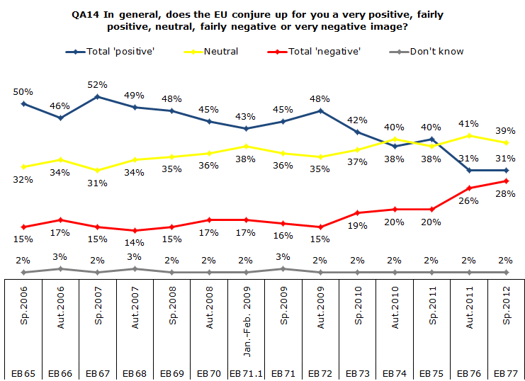
Europe’s existential crisis

