Slide 1
Transatlantic relations in the 21st Century: Why Europe still matters
Dr. Erica E. Edwards
Executive Director
European Union Center of Excellence
UNC Chapel Hill
eedwards@email.unc.edu

Slide 2
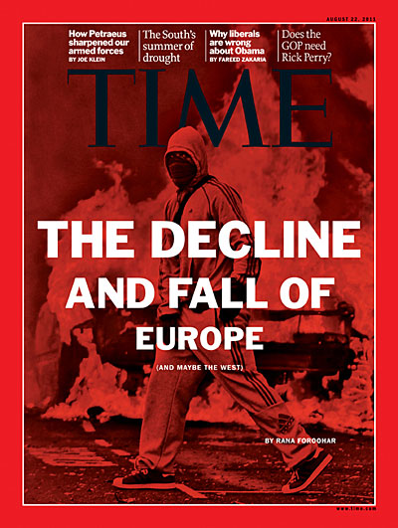

Slide 3
Theoretical perspective
Realist view of international relations
Nations engage in zero-sum competition by mobilizing coercive power resources.
Demographic and economic power converted to military power.
World is uni-polar, i.e. US is sole superpower.
Liberal view of international relations
Varied underlying national interests that influence foreign policy decisions.
International interactions are positive-sum, rise of more than one country possible and even beneficial.
Global influence rests on civilian power.

Slide 4
Europe’s Military might

Slide 6
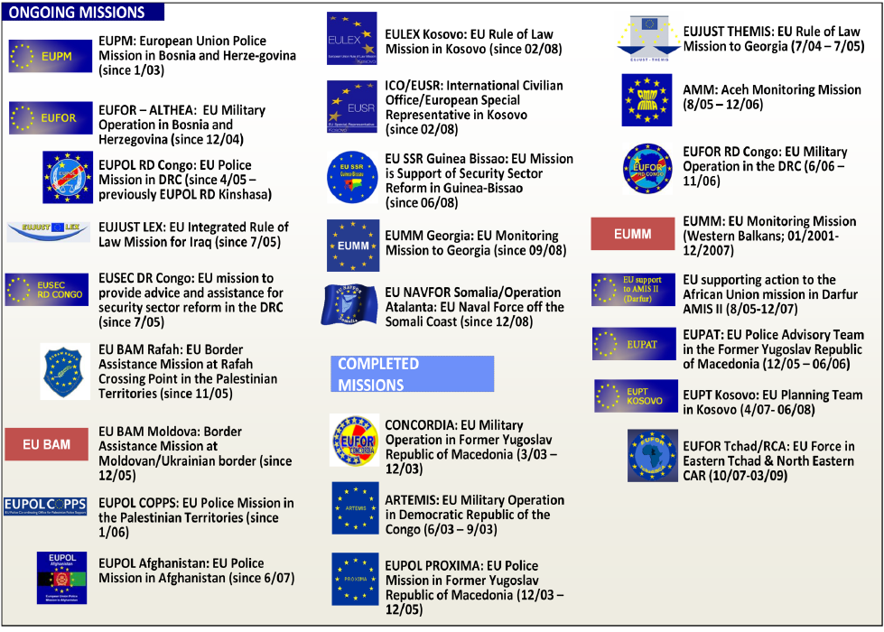

Slide 7
Europe, a “quiet” superpower

Slide 8
Europe’s comparative advantage is its power of attraction.
Economic influence
International law
Soft power, i.e. capacity to attract others to your way of thinking
Smart power, i.e. matching military and civilian forms of influence
Best example = EU enlargement

Slide 9
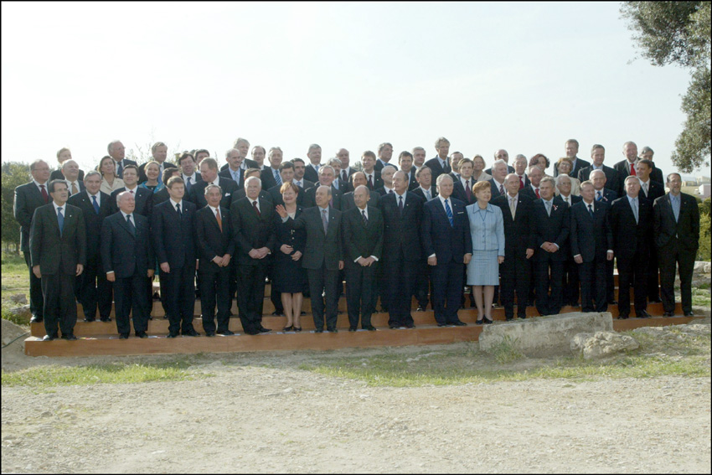
Power of attraction
EU enlargement as an instrument for regime change
“Marshall plan” aid for CEEC in return for commitment to: democracy, minority rights, anti-death penalty, sustainable development
Leverage: Active + Passive
Leverage = active + passive

Slide 10
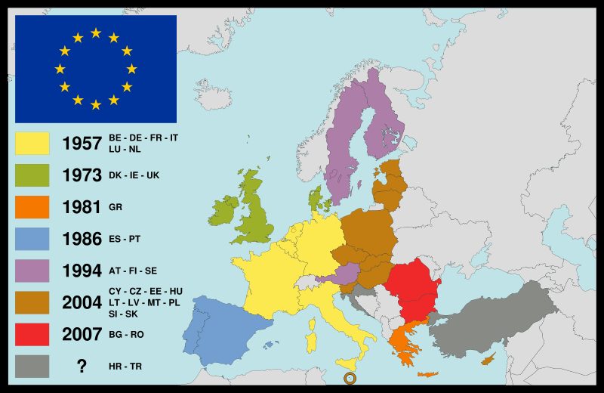
Notes:
Scandinavian countries: wealthiest, most homogenous, most equal societies.
Three Baltic countries: twenty years ago part of USSR, now members of the European Union. Kaliningrad.
Slovakia, Romania, Ukraine – former Soviet bloc. In or out EU?
France and Algeria: former colony. Immigrants.
Greece and Turkey: old enemies. Greece became independent from Turkey in 19th Century. Last major population movements after first WW.

Slide 11
Impact of successive enlargements (1958-2007)
 | 1958 | 1973 | 1981 | 1986 | 1995 | 2004 | 2007 | US | NC
Area (1000km) | 1,167 | 1,524 | 1,658 | 2,252 | 3,234 | 3,892 | 4,343 | 9,631 | 139
Population (millions) | 185 | 273 | 287 | 338 | 370 | 457 | 501 | 300 | 9.4
Member States | 6 | 9 | 10 | 12 | 15 | 25 | 27 | 50 | 100
Official Languages | 4 | 6 | 7 | 9 | 11 | 20 | 22 | 1 | 1
MEPs | 142 | 198 | 434 | 518 | 626 | 732 | 736 | 435+6 | 170
Notes:
Growing pains!
United States — Area - Total: 9,631,420 SQ KM
European Union Area is 4,343,000 sq km
EU27 population is about 500 M
Greece is closest to NC 131 Km2

Slide 12
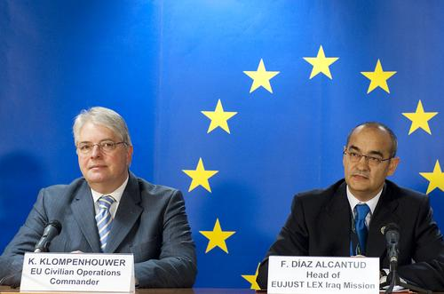
Embedded multilateralism
Primacy of international law [UN Charter]
Intervention to promote peace [Petersburg tasks; rapid reaction force]
Project EU norms globally [abolition of death penalty]

Slide 13
differing models of world politics
Classical sovereignty
External: state is subject to no other state
Unitary : state authority resides in one institution
Implication: no interference in other states’ affairs; preference for isolationism and unilateralism; hard power
Revisionist sovereignty
Pooled : state (should) share authority with other states
Divided: state authority can be partitioned
Implication: interference is OK; preference for multilateralism; soft power

Slide 14
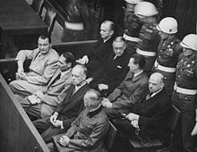
Postwar us foreign policy
Embedded multilateralism
Primacy of international law
Peace as overriding goal
Project US norms: democracy, rule of law, human rights
Cornerstone: US put its faith and backing in UN institutions
Power of attraction
Structure international institutions in its image [UN family]
Co-option, cultural attraction [foreign students]
Set example: values, consistent policies [Nuremberg Trial]
Carrots [aid: Marshall plan]

Slide 15
Europe, a global economic force

Slide 16
EU’s 500 million strong single market is the world’s largest trading entity and the world’s largest economy (worth approx $18 trillion annually).
EU is the largest importer/exporter in the world.
Intra-firm trade, investment, R&D – keys to modern economic activity – are where Europe thrives.
Europe is institutionally able to exploit it economic position.

Slide 17
A dynamic transatlantic economy
Transatlantic economy is largest and wealthiest market in the world: 54% world GDP.
EU and US together account for 40% of total global trade (more than $1.5 billion in transatlantic trade every day).
The $5 trillion EU-US transatlantic economy employs 15 million workers on both sides of the Atlantic.

Slide 18
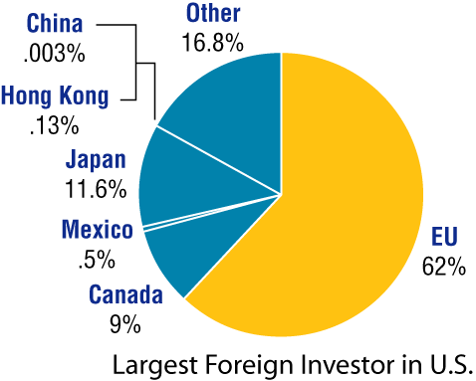
Foreign Direct Investment
European companies are the leading foreign investors in the U.S.
UK, Germany, France, and Netherlands – top four sources of jobs created by foreign investment in the US.
American companies invest far more in EU countries than in Asia.
60% of US FDI over last decade was in Europe vs. 3.7% in BRICS
US businesses make 5 times the profit in the Netherlands - alone - as they make in China.

Slide 20
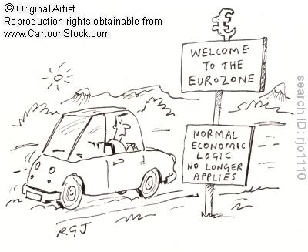
The Euro
Only serious alternative to dollar as a global reserve currency.
At end of 2008, approx 45% of international debt securities denominated in dollars vs. 32% in euros.
ttttttttttttttttttttttttttttttttttt

Slide 21
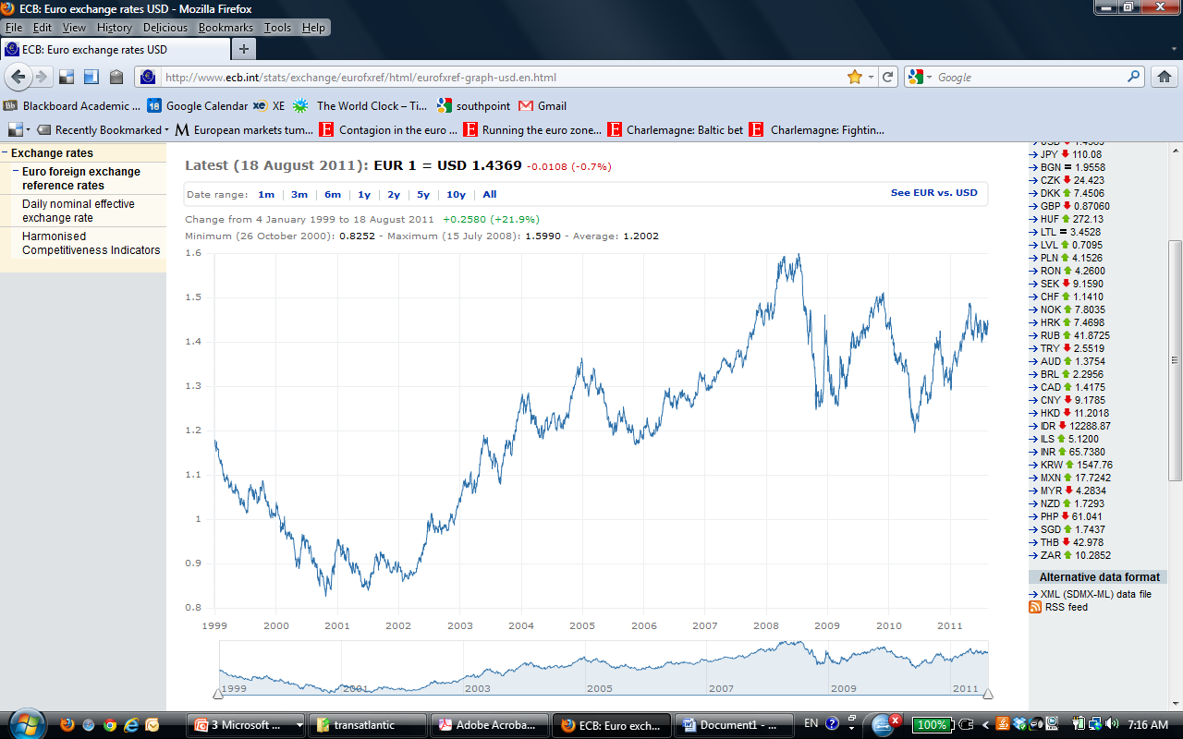
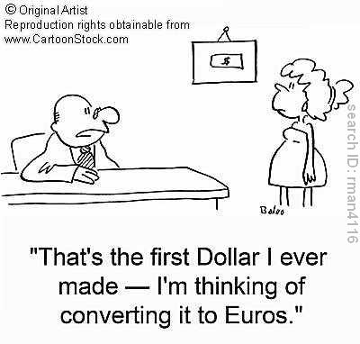
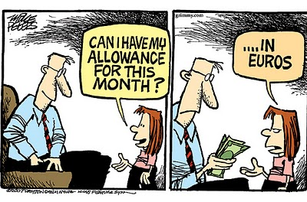
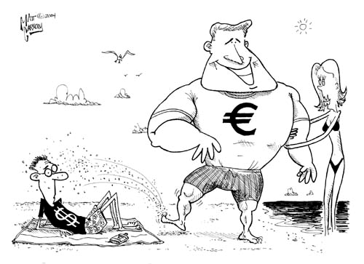

Slide 22
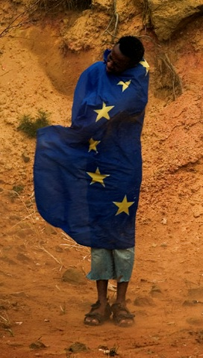
EU versus US Foreign Aid
EU member states and European Commission dispense 50% of world’s foreign aid; US share is only 20%.
Europe excels in delivering development services.
EU also exceeds US in disbursement of private aid (2007, EU=$170,197 million vs. US=$107, 282 million)

Slide 23
Carrots vs. Sticks (billion $)
Source: OECD statistics, 2008

Slide 24
Foreign aid (billion $)
Source: OECD statistics, 2005, 2009

Slide 25
Europe’s future

Slide 26
Why Europe’s influence will rise
Demographic and economic indicators of decline are exaggerated.
Aggregate population and GDP are wrong measures of power. Better one is per capita income.
Decreasing material and ideological conflict between Europe and other countries, i.e. converging international interests.

Slide 27
Thank you for your attention! Questions?
Dr. Erica E. Edwards
Executive Director
European Union Center of Excellence
UNC Chapel Hill
eedwards@email.unc.edu

